Slide 1
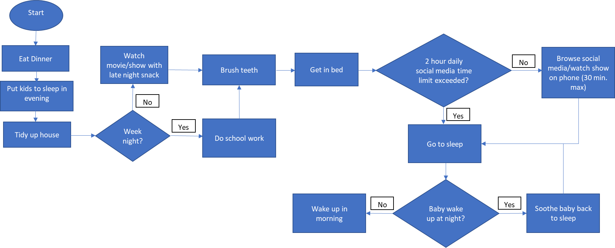
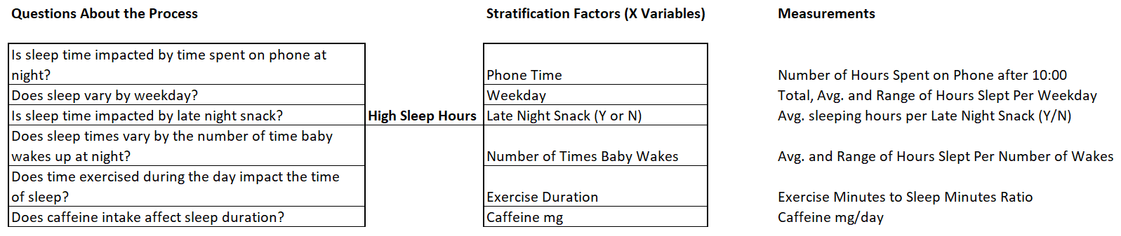
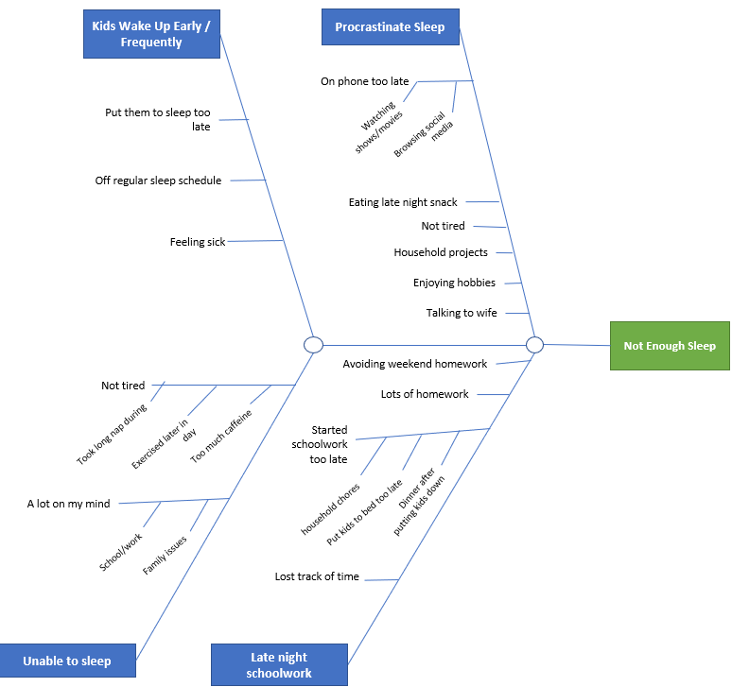
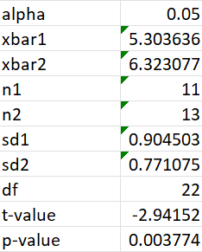
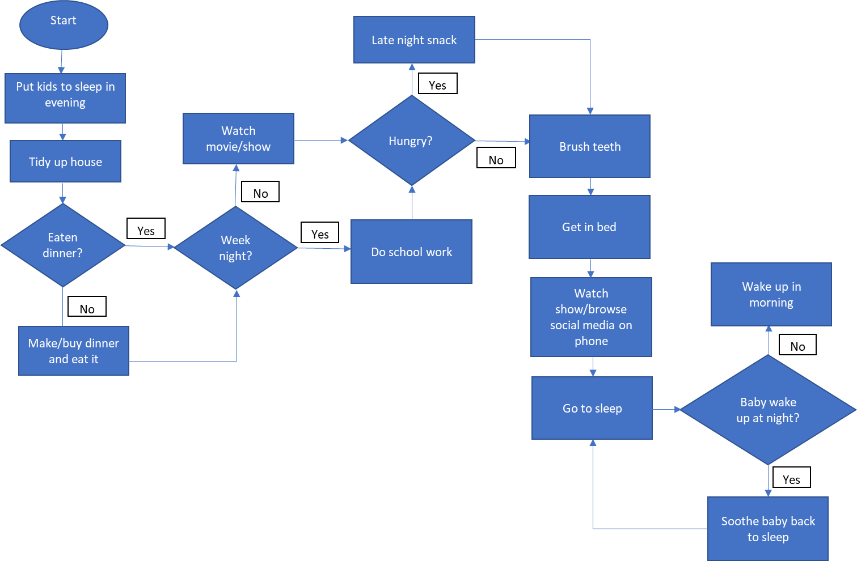
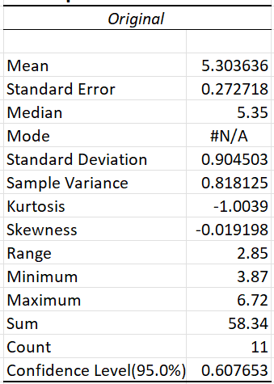
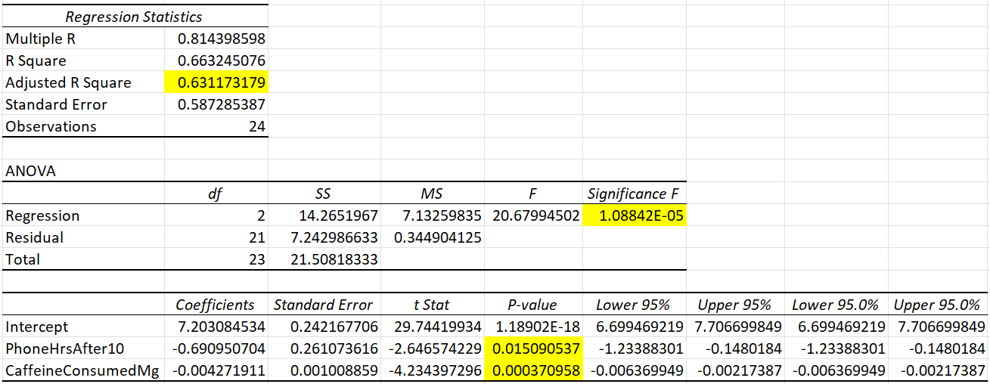
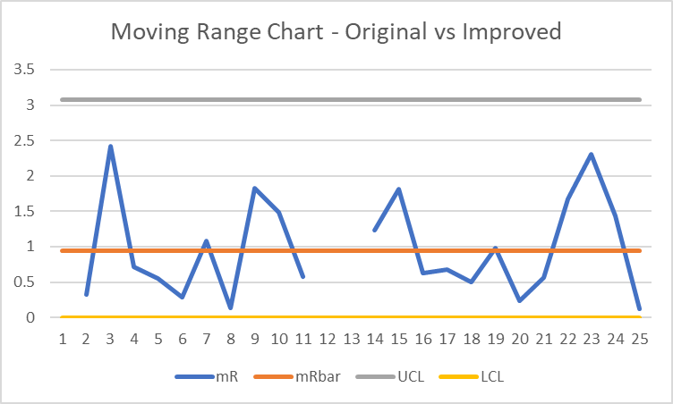
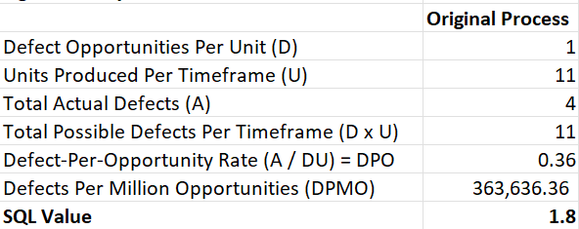
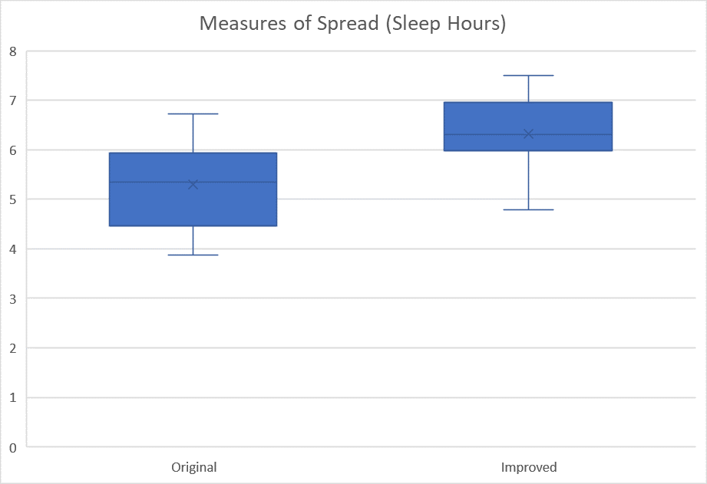
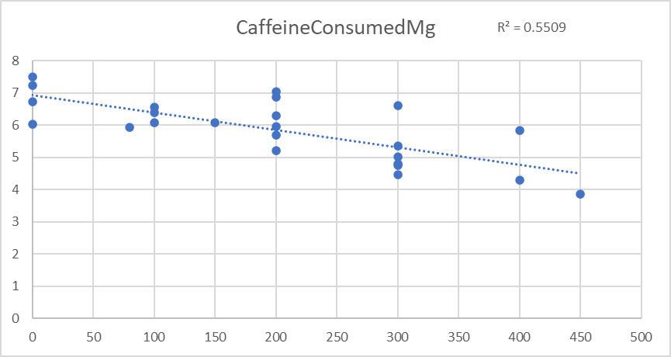
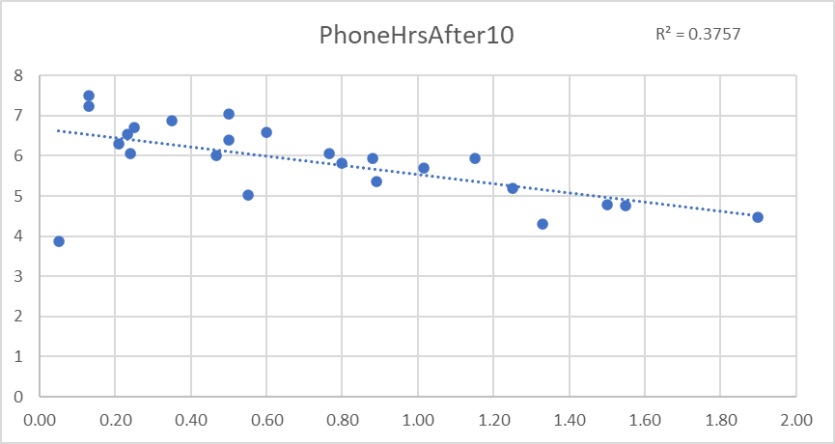
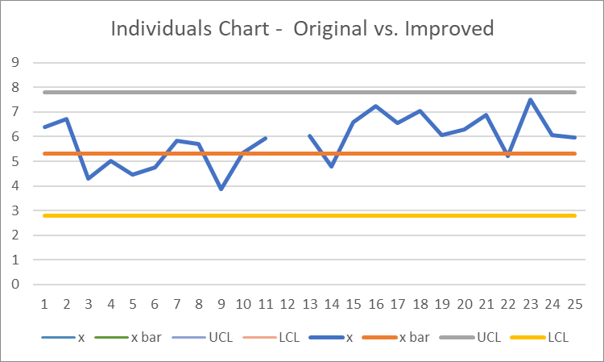
Process Improvement Project: Increase Sleep Hours at Night
MBC 638
Process owner: Michael Morrey
Key Dates ->
Define - 10/5/2022
Measure - 10/12/2022
Improve - 11/16/2022
Analyze - 11/2/2022
Control - Ongoing
DEFINE
MEASURE
Data Stratification Tree
ANALYZE
Effects: Not Enough Sleep
Kids wake up early/frequently
Unable to fall asleep
Procrastinate sleep
Late night schoolwork
Root causes:
Exercised late in day
Too much caffeine
Too much homework
Late night snack
On phone too late
IMPROVE
Problem: Not getting adequate sleep at night
Business Impact: Loss of focus during the workday, resulting in decrease in problem-solving ability and work performance, while increasing time spent on projects.
Loss of sleep results in an estimated loss of 1 hour per workday on average, resulting in annual company cost of $9,800
Goal: Increase hours slept per night to 7 hours
Altered Daily Process:
Dinner before kid bedtime
30 min. Social media cap after 10:00 p.m. (No phone if 2 hrs. Already exceeded during the day)
Eliminate bedtime snack
Improved Process Map
Process Questions:
Is sleep time impacted by time spent on phone at night?
Does sleep vary by weekday?
Is sleep impacted by late night snack?
Does time exercised during the day impact the time of sleep?
Does caffeine intake affect sleep duration?
Cause & Affect (Fishbone)
SQL = 2.9
Ho: u1 >= u2
The new process will not increase sleep hours
Ha: u1 < u2
The new process will increase sleep hours
Hypothesis Testing
Original Process Map
Find the relationship between Y (Sleep hours) and X variables (Phone hours after 10:00 p.m., caffeine consumed in mg, exercise hours, and late night snack)
Multilinear Regression
Descriptive Statistics
(Baseline)
P-value < alpha
Reject Ho: Statistically significant evidence for a decrease in sleep hours in improved process
Average sleep time = 5.3 hours per night
CONTROL
Moving Range (Original vs Improved)
Several non-value add (NVA) steps leading up to sleep time
Std Dev = 0.9
Statistically significant X variables:
CaffeineConsumedMg
Coefficient: -0.004
PhoneHrsAfter10
Coefficient -0.69
Original: Left
Improved: Right
Range consistent between baseline and new process
Box and Whisker
Baseline:
Q1: 4.47 hrs.
Mean: 5.3 hrs.
Q3: 5.93 hrs.
Middle 50% of sleep hours fell between 4.47 and 5.93 hours
Caffeine (mg) vs. Sleep Hrs.
Phone Hrs. vs. Sleep Hrs.
Individuals (Original vs Improved)
Original: Left
Improved: Right
Improved is different from baseline (out of control)
Continue to monitor improved process
SQL = 1.8
Phone hours after 10:00 p.m. and caffeine consumed are negatively correlated with Y (sleep hours)

Slide 2
DMAIC
Original Process Flow Chart
Problem Statement:
Lately I have had a problem of not getting adequate sleep at night. I know this because I often feel very tired during the workday. To keep myself energized and focused, I often buy energy drinks or take short power naps throughout the day. On top of the potential health risks, lack of sleep has caused loss of focus at work, and less energy to spend quality time with my wife and kids.
Goal:
Increase my hours slept per night to 7 hours. I will know I have been successful if my improved process increases to at least an average of 7 hours of sleep.
Original process for nighttime routines before sleep:
This process costs my company an estimated $9,800 per year, based on an estimated 1 hour of productive time lost per 8-hour workday.
Non-value Add (NVA) steps to be considered for improvement:
Watch movie/show
Late night snack
Watch/browse social media on phone

Slide 3
DMAIC
Data Stratification Tree
All X variables identified here were measured except Number of Times Baby Wakes. It wasn't realistic to record this data during these hours of experiencing exhaustion. Collecting this data point may be more obtainable when the baby is older and waking up less frequently.

Slide 4
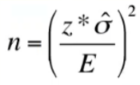
DMAIC
Data Definitions and Measurement Methods
Data Collected and Operational Definitions:
Continuous:
Sleep Hours: Number of hours of sleep I obtained in a night
Phone Hours: Number of hours spent looking at my phone after 10:00 p.m. before a sleep night
Caffeine Consumed: Milligrams (mg) of caffeine that I consumed the day prior to going to sleep
Exercise Hours: Number of hours I exercised during the day prior to going to sleep
Discrete:
Late Night Snack: Whether any item of food was eaten after 10:00 p.m. before a sleep night (Yes or No)
How data was collected:
Sleep hours and exercise hours were collected using the health and exercise apps, respectively, on my Apple Watch.
Phone hours were tracked using built-in tracking software on my iPhone.
Caffeine consumed was tracked by manually entering the mg consumed into my iPhone every time I drank something containing caffeine.
Late night snacks were tracked by manually entering a yes or no onto my iPhone every night before sleep.
Amount of Data Collected:
Due to time constraints, 11 days' worth of the baseline data was collected.
Amount of improvement data was calculated to be 13 days using Sample Size Calculation:
Z = 1.96 (2-sided)
Sigma = 0.9 (standard deviation)
E = 0.5 (margin of error)
95% Confidence Level
n = (1.96*0.9/0.5)^2 = 12.446784
Rounded up: n = 13
I needed 13 days of data to be 95% sure my average hours per night of sleep was within +/- 0.5 hours.

Slide 5
DMAIC
Measurement Error
Potential measurement error:
Apple Watch measures sleep based on movement and heart rate. In the case of being awake and still, it has potential for recording sleep hours when I am awake.
Exercise app may capture too much or not enough workout time depending on whether I forget to start or stop the watch at the beginning or end.
Potential technical issues with watch or phone at the time of measurement.
When taking pre-workout, caffeine intake is estimated based on where the powder level is in relation to the size of the scoop, causing room for error.
When partially drinking an energy drink, caffeine intake is estimated based on mg of caffeine indicated on the can.
Minimizing measurement error:
When taking pre-workout, use measuring cups instead of scooper found in container to get a more precise measurement.
When partially drinking energy drinks, first pour desired amount into a measuring cup.
Continually update watch and iPhone to ensure potential bugs are rectified and latest technology is being used.

Slide 6
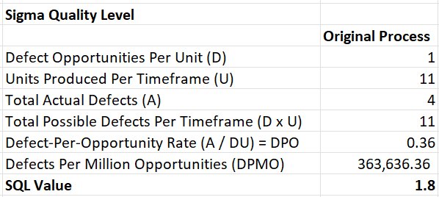
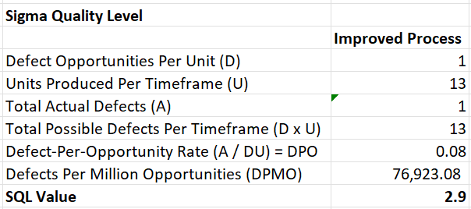
DMAIC
Original Process Sigma Quality Level (SQL)
1 Unit = 1 Night of Sleep
Original process timeframe = 11 days
Improved process timeframe = 13 days
Potential Defects: 1
Less than 5 hours of sleep in a night
Based on prior experience, I have found that my mental and physical focus significantly decreases with less than 5 hours of sleep in a night.
Original Process SQL
Improved Process SQL
SQL improvement found between original process (1.8) and improved process (2.9)

Slide 7
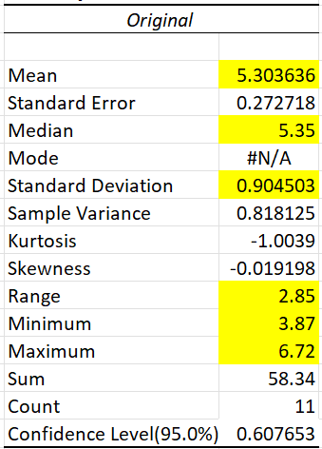
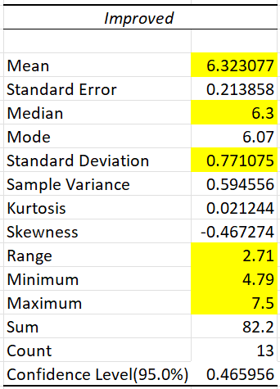
DMAIC
Descriptive Statistics / Box and Whisker
Descriptive statistics were used to measure central tendency and dispersion in the original process and improvement process. The two result sets could then be compared.
Results:
Improved process saw an increase in mean and median sleep hours by 16.14% and 15.08%, respectively.
Standard deviation and range decreased from the original to improved process, showing smaller variation in sleep hours in the new process.
The maximum hours slept in the improved process were above the goal of 7 hours slept, whereas the maximum in the original process was below the 7-hour goal.
Both the original and improved minimums were considered defective (less than 5 hours of sleep).
The box and whisker plot can further help to visualize the spread and central tendency found in the descriptive statistics.
Results:
There is an apparent shift upwards in sleep hours in the improved process.
The baseline data show an interquartile range (IQR) between roughly 4.5 and 5.9 sleep hours. The middle 50% of sleep hours fell between these numbers. In contrast, the IQR for the improved process was between roughly 6 and 7 hours of sleep.
The maximum sleep hours of the original process falls slightly below the 3rd quartile in the improved process.

Slide 8
DMAIC
Cause & Effect (Fishbone)
Because of the large number of variables that could be affecting my sleep, the Cause and Effect (Fishbone) diagram was used to brainstorm potential causes to not enough sleep.
Key causes to kids waking up too early:
Sick kids
Kids not on regular sleep time routine
Key causes to being unable to fall asleep:
Not tired due to taking a long nap during the day and too much caffeine
A lot on my mind due to family issues or schoolwork
Key causes to procrastinating sleep:
On my phone too late watching movies or browsing social media
Eating late night snacks
Key causes to late night schoolwork:
Started schoolwork too late due to having dinner after putting kids to sleep and household chores
While not all these potential causes were used in my further analysis, they should be considered again beyond this project.

Slide 9
DMAIC
Multilinear Regression / Scatterplots
Regression analysis was used to determine which X variables were related to the Y variable (sleep hours).
Upon running the analysis using all X variables (phone hours after 10:00 p.m., caffeine consumed in mg, exercise hours, and late-night snack), only phone hours after 10:00 p.m. and caffeine consumed in mg were found to be statistically significant (p-values < .05 alpha). As such, the regression was re-run using only those two X variables. This resulted in the following results:
Results:
Predictive Equation:
Y = 7.203 - .691 phone hrs - .004 caffeine consumed
Adjusted R-square = 0.63
63% of the variation in sleep hours can be explained by the variation in the model
Coefficients:
PhoneHrsAfter10: -0.691
CaffeineConsumedMg = -0.004
The Phone hours after 10:00 and caffeine consumed are both negatively correlated with sleep hours. This is also illustrated in the downward slope shown in the scatterplots below.
Caffeine (mg) vs. Sleep hours
Phone hours vs. Sleep hours
The caffeine trend line appears to be steeper, indicating slightly stronger negative correlation

Slide 10
DMAIC
Improved Process Flow Chart
Adjustments:
Eating dinner was moved to before putting kids to sleep. Making a conscious effort to always eat at this time allowed for less steps in the later hours.
After getting in bed, if 2-hour social media limit had already been hit for the day, then go straight to sleep. If not, a 30-minute max was allowed for decompression.
Late night snack was taken out of the process. This removed a non-value add (NVA) step.

Slide 11
DMAIC
Hypothesis Testing
Ho: The new process will have no effect on sleep hours
u1 >= u2
Ha: The new process will increase sleep hours
u1 < u2
t-value < alpha
-2.94 < .05
Conclusion:
Reject the null hypothesis. There is significant evidence to suggest that sleep hours in the new process increased from the original process.
Due to the small sample size, Nightly sleep hour samples will continue to be taken to ensure the new process results in increased sleep hours.

Slide 12
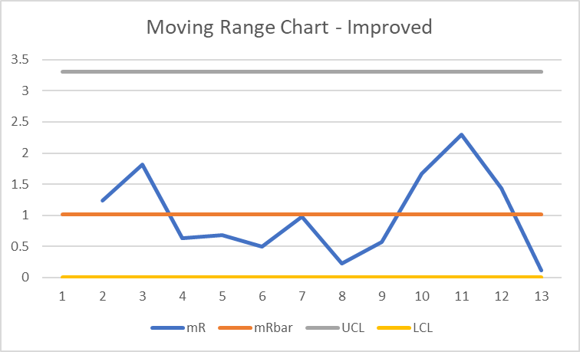
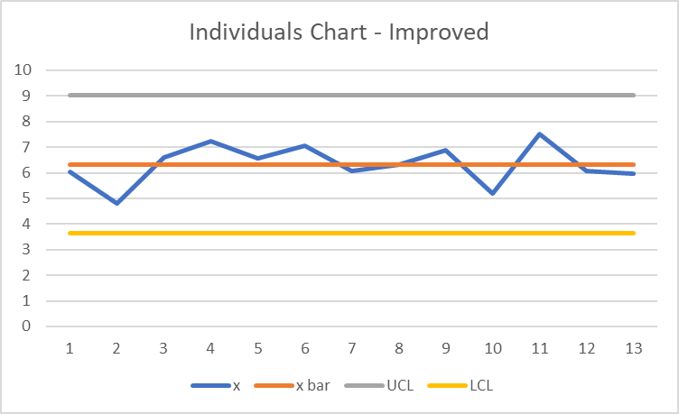
DMAIC
Control Charts
Sleep hours were evaluated with process control using ImR charts, due to having continuous data and a subgroup size of 1 (n=1).
Upper control limits (UCL), lower control limits (UCL), and averages were plotted using the baseline data. The baseline and improved processes were then plotted and compared.
Baseline
Process
Improved
Process
Moving Range Chart is in control.
Sleep hours from Baseline and improved processes fluctuate similarly day-by-day.
Process control for improved process was evaluated by itself.
Charts appear in control.
Improved process will be monitored moving forward.
Baseline
Process
Improved
Process
Individuals Chart is out of control.
Most sleep hours from improved process fall above baseline average. This is good!

Slide 13
Conclusion
What was learned?
Improved process showed improvement over the baseline process:
SQL improved from 1.8 to 2.9
Descriptive statistics indicate increase in central tendency measures and decrease in variation
Hypothesis testing resulted in rejecting null hypothesis that the new process has no effect on sleep hours
Goal of 7 sleep hours per night on average was not achieved, despite average increasing between baseline and improved processes. To achieve this goal, the process can continually be improved by:
Improving the quality of the data collected
Measuring and evaluating other possible X variables identified in Fishbone Diagram and Data Stratification Tree
Adjusting Process Flow Chart to identify and remove Non-Value Add (NVA) steps
Thus far, phone hours after 10:00 p.m. and caffeine consumed (mg) appear to have the most negative correlation with sleep, based on multilinear regression.
Moving forward, control charts will continue to be used to monitor sleep hours.

